Slide 1

| Welcome to Java Blue |

Slide 2
| Agenda
Communication Tools Overview and Expectations
Git and Bitbucket configuration
Lecture Structure and Expectations
Time Expectations
Syllabus
Program Overview
Other things to expect on Week 1

Slide 3
| Java Blue Instructors
Brian Lauvray
primary instructor
Lecture
1-on-1s
Code Reviews
Support
Rachelle Rauh
co-instructor
Support during Lectures
Exercises
Support

Slide 4

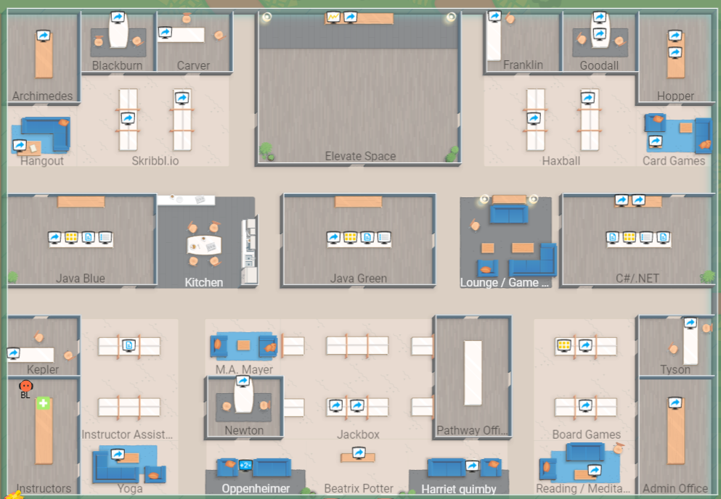
| SOCOCO
Log on each day and be online while you are working
Allows everyone to see who is working and available for help or collaboration.
Contains links to jit.si meeting rooms, Zoom classrooms, Cheatsheets, Slides, and other information
Meant to be used to show presence not as a communication tool.
Configuration:
Use your preferred real name
Make your icon a shade of blue
Set your Home Room to Java Blue classroom
Go to Java Blue Classroom
Right Click on room and select “Set as Home Room”
Virtual Presence
Please make your icon a shade of Blue

Slide 5





| Communication Tools
Slack
Class, pathway, direct messages, and support
CALENDAR
Scheduled events such as Pathway, 1-on-1s, and Reviews
ZOOM
Classroom and group session.
HANGOUTS
Student-Initiated Video Conferencing and 1-on-1s
JIT.SI
Student-Initiated Video Conferencing, Support, and Collaboration

Slide 6

| Communication Expectations
SOCOCO
Online when working. Change to appropriate status (Away, Available, etc.)
SLACK
Be logged in during class. Check frequently throughout the day and after hours and weekends. Strongly encouraged to set up phone notifications.
CALENDAR/EMAIL
Check your email regularly for invitations. Check calendar for where to be. Make sure techelevator.com are not going to spam!
ZOOM
During Lecture - Video ON is required! Use your First and Last Name (first name should be what you prefer to be called).
DASHBOARD
Check daily for comments and scores

Slide 7


| Instructional Tools
DASHBOARD
Quiz, Exercise Scores, and comments on your code
STUDENT BOOK
Custom content that follows the daily lectures and often adds more advanced detail.
BITBUCKET
Lecture & Exercise Code Distribution
GIT
Source code version control

Slide 8

| Bitbucket and GIT Configuration
In Git Bash terminal change to your source directory using the following command: cd ~/source/repos
Clone your java-blue repository (yourname-java-blue NOT java-blue-main)
Can paste into Git Bash using SHIFT-INSERT or by right clicking and selecting Paste
Change directory to your-java-blue-material folder: cd <yourname>-java-blue
Run the setup script, it will ask for your first and last name and email address. Use your real name and email. Potential employers will see this information! sh setup.sh
Once it says “done”, Verify the remote repository is setup by retrieving the welcome-to-java-blue.txt file: git pull upstream main
List the contents of the directory and verify welcome-to-java-blue.txt exists ls

Slide 9
| Lecture Structure
Be in the classroom by 9am each morning with Video on.
Daily Pulse Survey
Required
Be honest - I review these daily and try to react to what the class needs, which may include reviewing material, adapting style, or changing the speed of presentation.
Quiz
Lecture
Goes until the material is finished. Usually wraps up between 12 and 1, but not always!
Daily Announcements

Slide 10
| Lecture Expectations
Be on time
Video on is required.
Turning your video off will be considered you leaving the room and will count as absent time.
Communicate
If you are going to miss lecture, be late, need to step out, or leave early you must message me and/or Rachelle on Slack as soon as possible.
Interact!
Unmute yourself and just say “I have a question” or “I need some help”
Put it in Chat
Don’t be afraid to speak up!
Message Rachelle
Give the material your full attention.
While lectures are recorded you can’t rely on them. Sometimes available in an hour, sometimes a day or two, and sometimes things go wrong with the recording.
Be prepared to not always “get it” right away, and understand that is normal and OK.

Slide 11
| Time Expectations
You are expected to treat this like a full time job, but really it will be more than that.
Working hours are Monday through Friday 9am - 5pm.
You are expected to be available during that time
You are expected to be available to and to do work with pair partners
We don’t count the weekend in deadlines, but you are expected to keep up, and that will often include working after working hours and on weekends.
Most students spend 60-80 hours per week during the program.
You are expected to be meet daily deadlines for exercises, but more on that on Monday!

Slide 12
| Syllabus
Kept in the CBUS Campus Calendar.
Each days entry has details, extra links, and other information about the day in the Calendar Entry details.
Each day indicates whether there are individual and/or pair exercises.

Slide 13
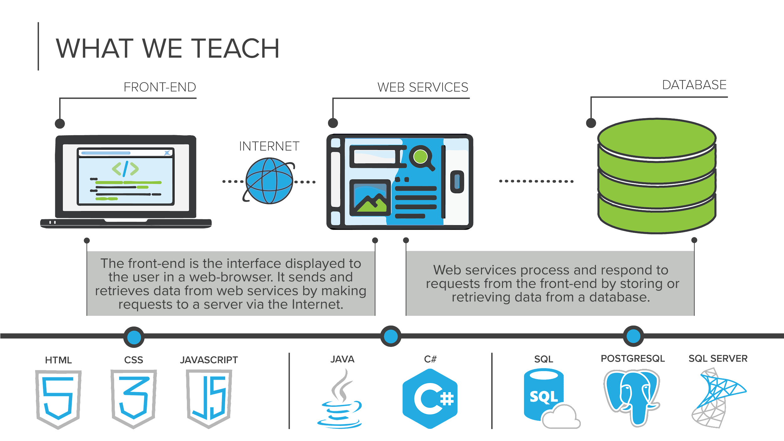

Slide 14







|Program Overview
WEEKS 1-4
WEEKS 5-8
WEEKS 9-12
programming fundamentals
databases and APIs
front-end programming
Learn object-oriented programming to compose larger programs together in Java
Work with development tools like Eclipse, and Git
Store and retrieve data using the Postgres relational databases
Consume and share data from our applications over the Internet using APIs
Develop web application interfaces using HTML, CSS, and JavaScript
Learn how create web components using the Vue.JS JavaScript framework

Slide 15
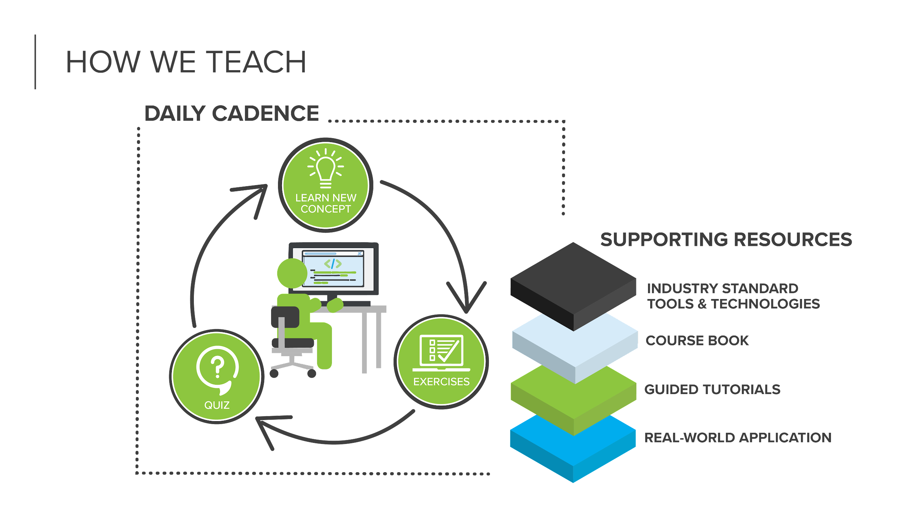

Slide 16
| OTHER THINGS TO EXPECT WEEK 1
While we will review many concepts learned during the prework, we cover a lot of ground.
As stated before, this program can be challenging. Each day can bring with it a good amount of work. Please make sure that you remain caught up and put in the time with each day.
I will conduct “one on one” meetings with each of you to get to know you and better understand any challenges that may make it difficult for you to be successful while you are here.

Slide 17

if ( haveQuestions == true ) {
ask();
}

